Slide 1


BAMBOO STRUCTURES
FOR SUSTAINABLE INFRASTRUCTURE
Presented By:
Dr. Chaaruchandra Korde,
Assistant Professor,
Centre for Technology Alternatives for Rural Areas (CTARA),
Indian Institute of Technology, Bombay (IITB)
Technical Director, Greenbam Infratech Pvt. Ltd. (www.greenbam.in)

Slide 2
Sustainable Infrastructure:
Materials, Structures, Technology Development, Demonstration and Dissemination
BAMBOO CONSTRUCTION FOR

Slide 3
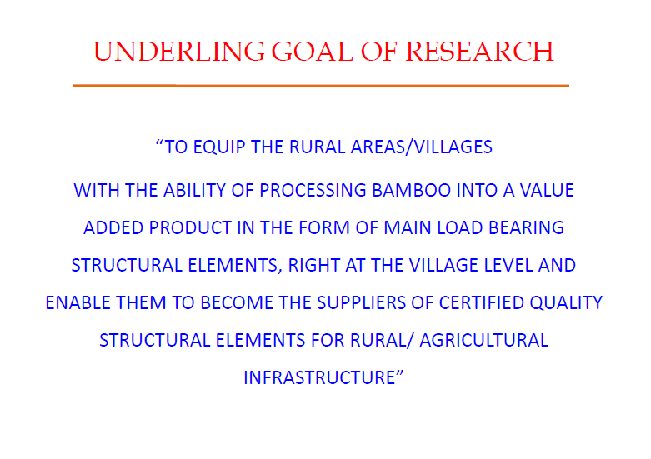

Slide 4
Bamboo Structures

Slide 5
BACKGROUND
Background:
106 hector of waste land of Allahabad, India due to brick mining upto 3-4 m depth
UTTHAN with help from INBAR converted it into fertile lands with Bamboo Cultivation
Won US $ 1 million ALCAN Award
Challenges:
Farmers have now fertile lands and are having rapid bamboo growth
Unable to find markets for sale of bamboo
The present markets like paper pulp, fire wood, handicraft, charcoal, etc have lesser consumptions and are giving low returns
Proposal:
Structural elements (Beam/column/wall)
Bamboo Construction
Bamboo Farming
(Rapid Growth)
(Rapid Consumption)
--: GAP :--

Slide 6
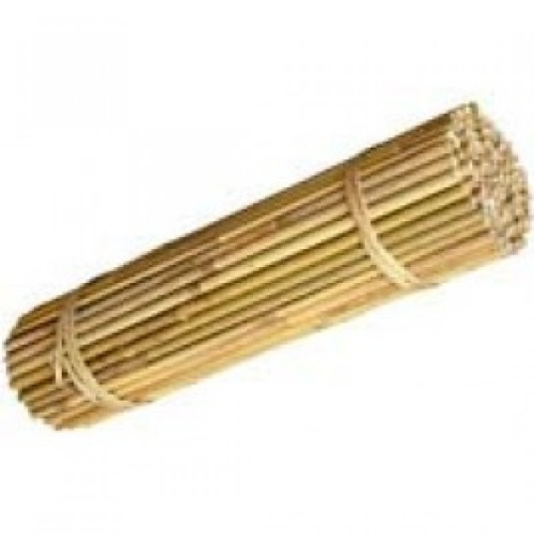

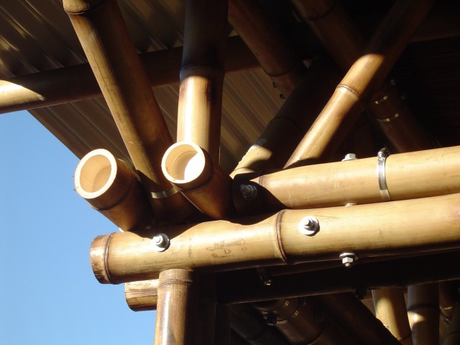
STRUCTURAL LOAD BEARING
HOW TO ACHIEVE A BETTER MOMENT OF INERTIA WITH BAMBOO

Slide 7
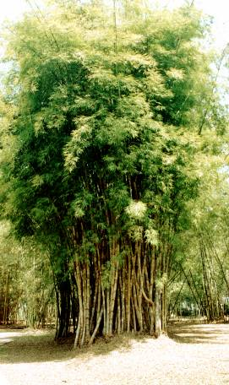
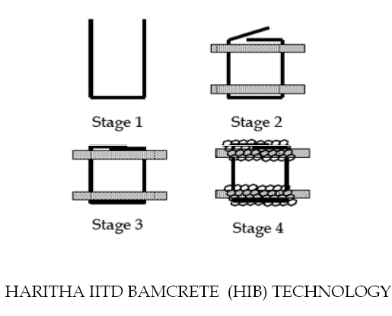
BAMBOO To HIB TECHNOLOGY
INDIAN INNOVATION,
FIRST OF ITS KIND IN THE WORLD

Slide 8
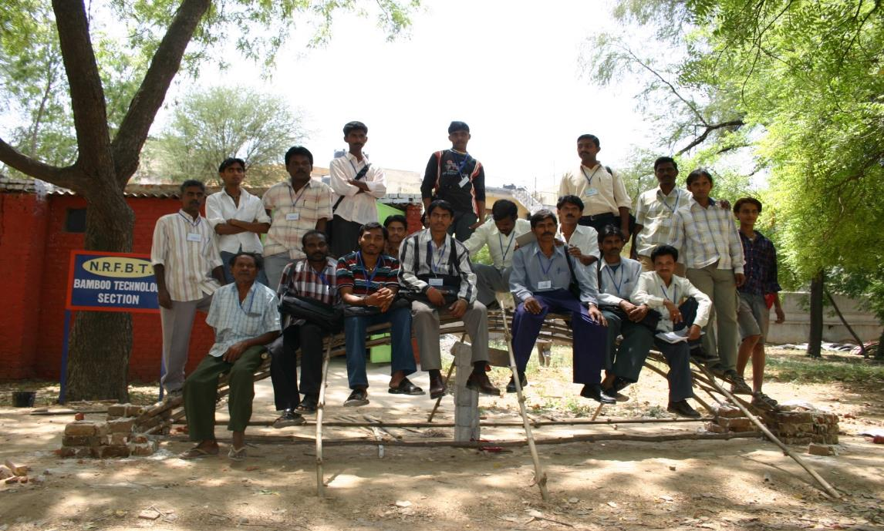
Dendrocalamus strictus
45 % of Indian Bamboo

Slide 9
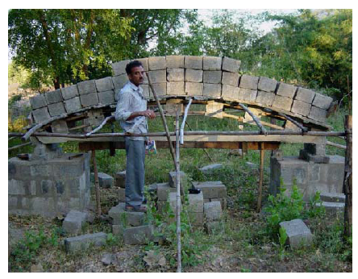
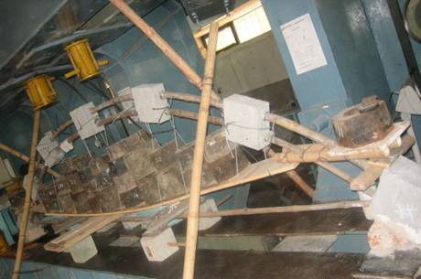
TEST SETUPS FOR TESTING ARCHES

Slide 10
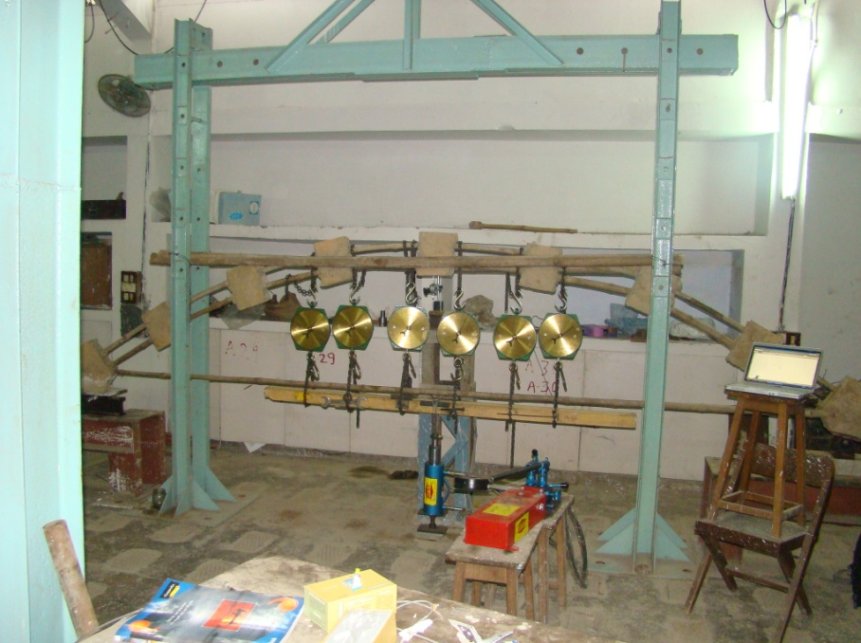
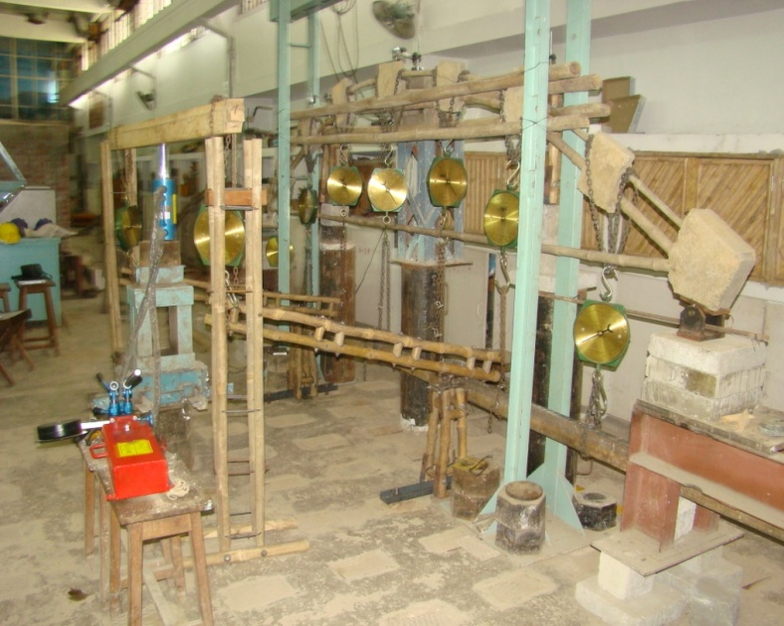
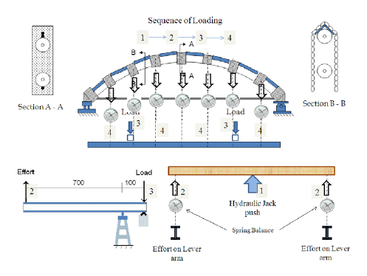
TEST SETUPS FOR TESTING ARCHES

Slide 11
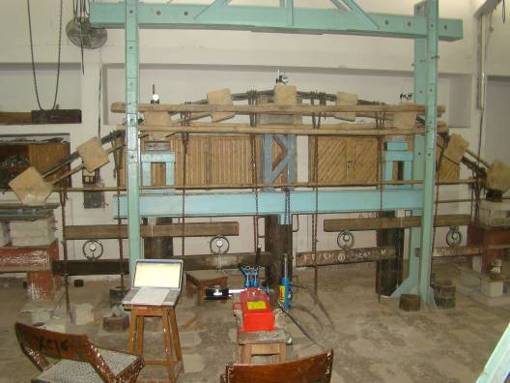
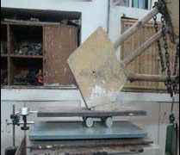
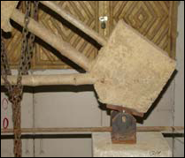
TEST SETUPS FOR TESTING ARCHES
Dial Gauge
Proving Ring
Hydraulic Jack
UNIFORM DISTRIBUTED LOADING SYSTEM FOR ARCH

Slide 12
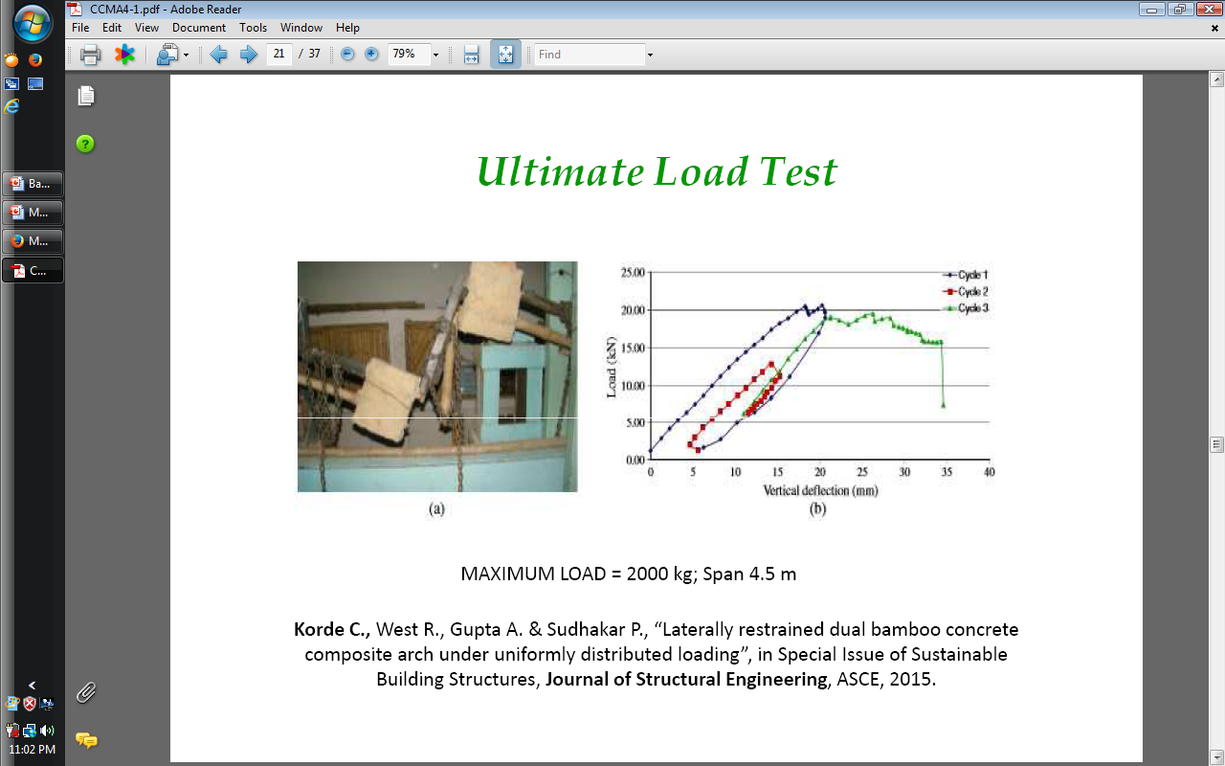

BAMCRETE ARCHES – 4 - 6 M

Slide 13
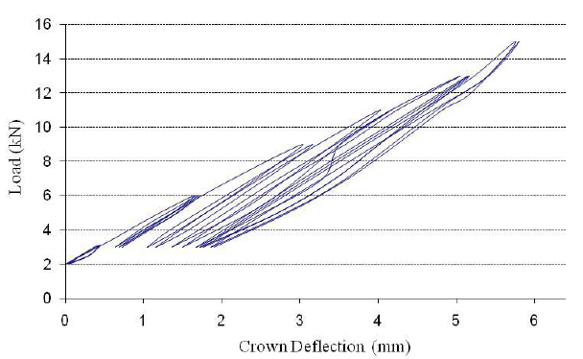
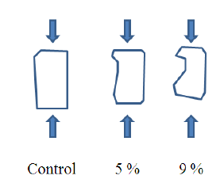
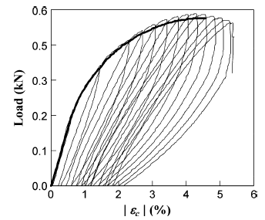
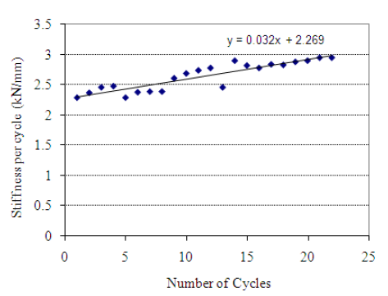
OBSERVATIONS
A continuous shift of deformation under cyclic loading for arch B and C
Linear non-elastic flexibility in bamboo (OBATAYA E. ET. AL., 2007)
A progressive increase in the stiffness of the arches with increasing cycles

Slide 14
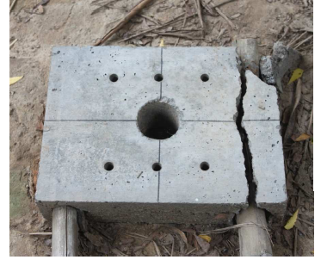
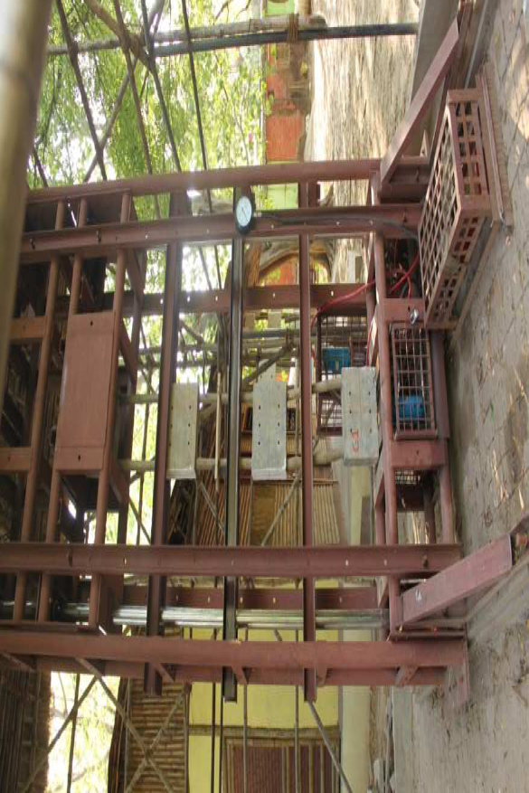
COLUMN FAILURE/ ULTIMATE LOAD
FAILED BAMBOO COLUMN
FAILURE LOAD: 4500 kg
Twin Bamboo column with HIB Joint
Korde Chaaruchandra, Ashok Gupta and P. Sudhakar, “Haritha-IITD Bamcrete Technology: A new perspective for Ferro-Bamboo-Concrete Composite Structures”, Indian Journal of Ferrocement, pg. 257, 2011. www.ferrocementindia.com

Slide 15
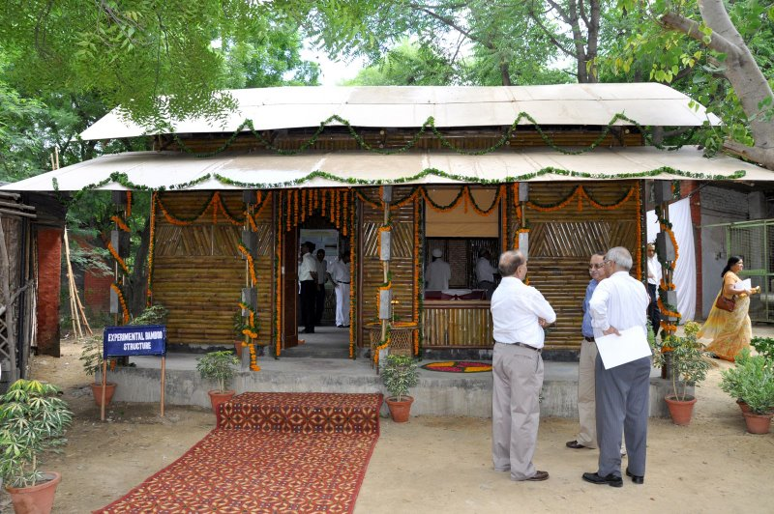
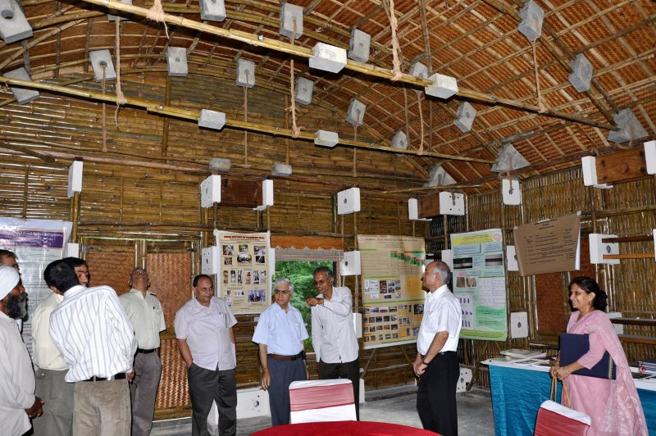
TECHNOLOGY DEMONSTRATION
10 YEARS OLD
IIT DELHI, 2009
Korde Chaaruchandra, Ashok Gupta and P. Sudhakar, “Haritha-IITD Bamcrete Technology: A new perspective for Ferro-Bamboo-Concrete Composite Structures”, Indian Journal of Ferrocement, pg. 257, 2011. www.ferrocementindia.com

Slide 16
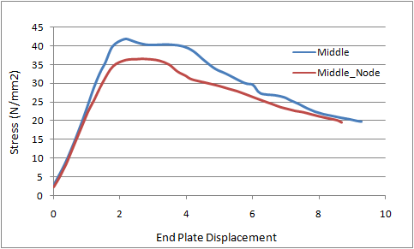
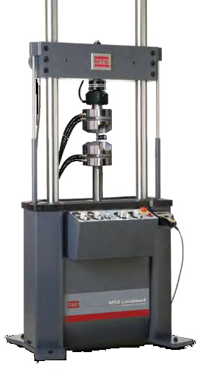
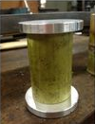
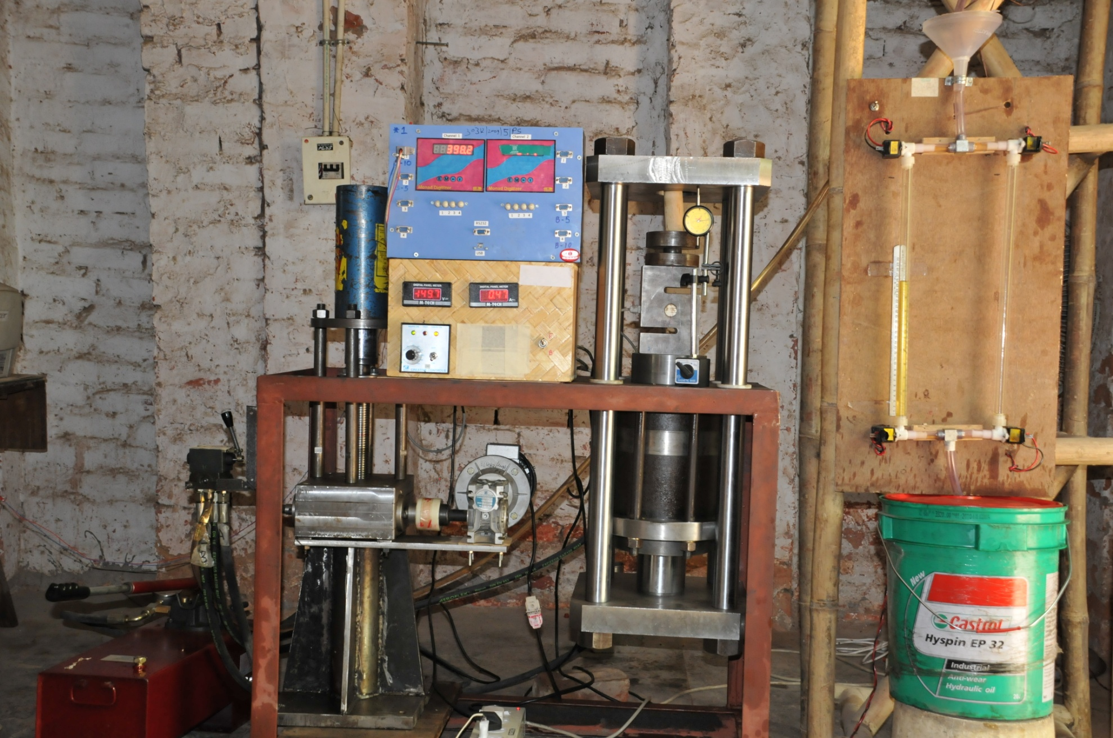
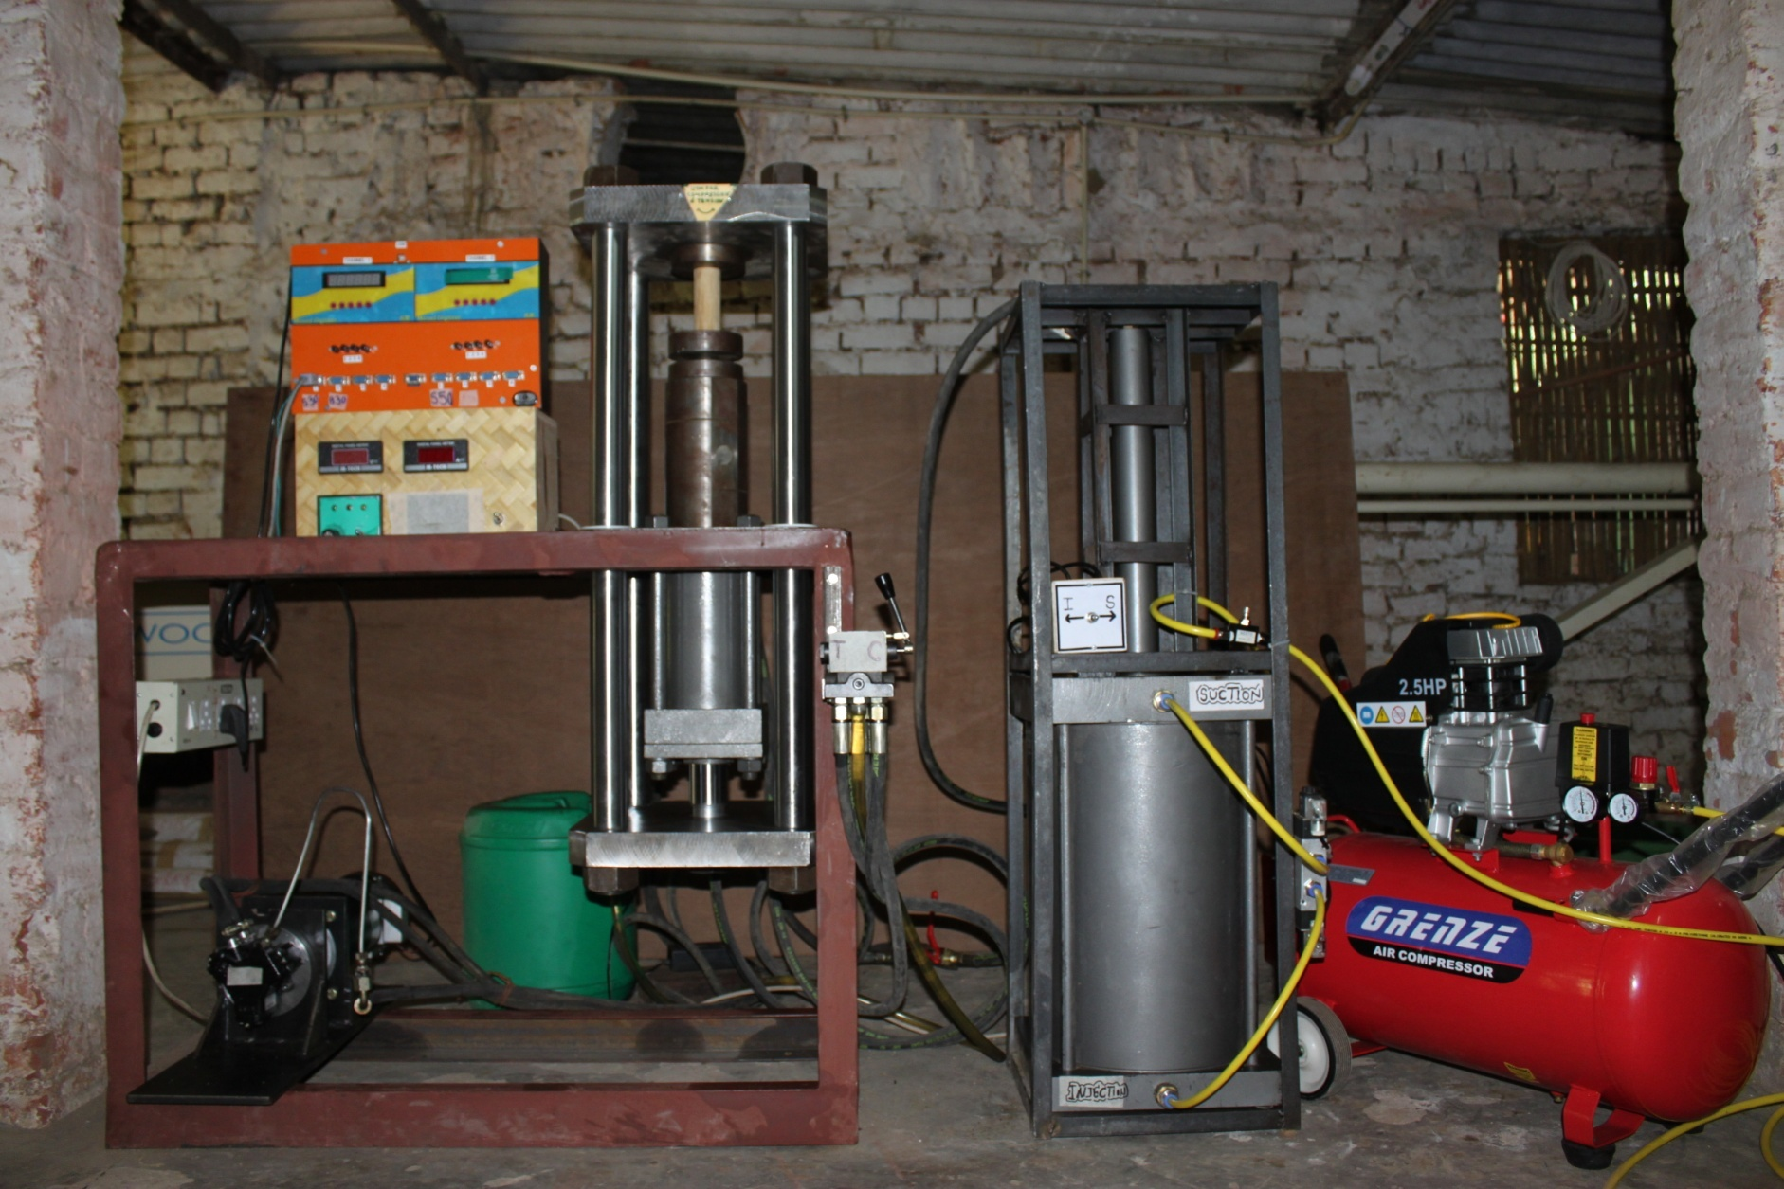
MATERIAL TESTING & EQUIP. DEVELOPMENT
4000 Kg Load
MTS TESTING MACHINE
COST: ~ 100 LACS
L/d Ratio = 2
(mm)
LOW COST TEST EQUIPMENT
COMPRESSION TESTING
CYCLIC/FATIGUE TESTING
TENSION TESTS
BENDING TEST
COST: 7-10 LACS….!!

Slide 17
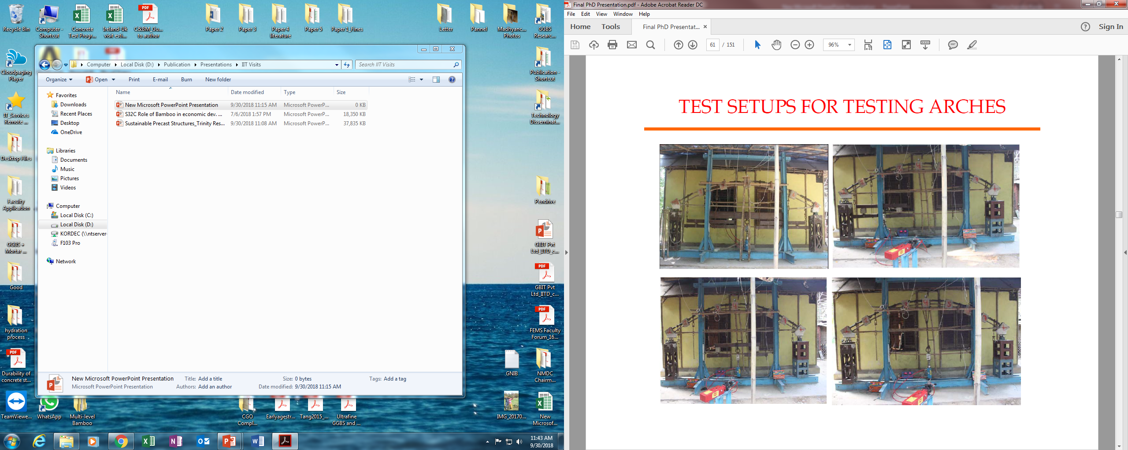
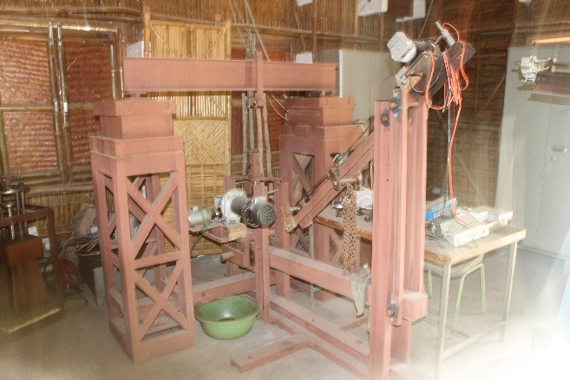
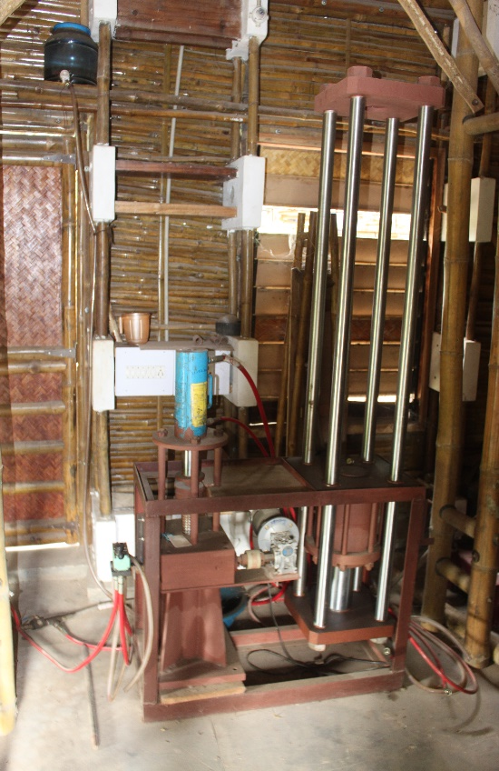
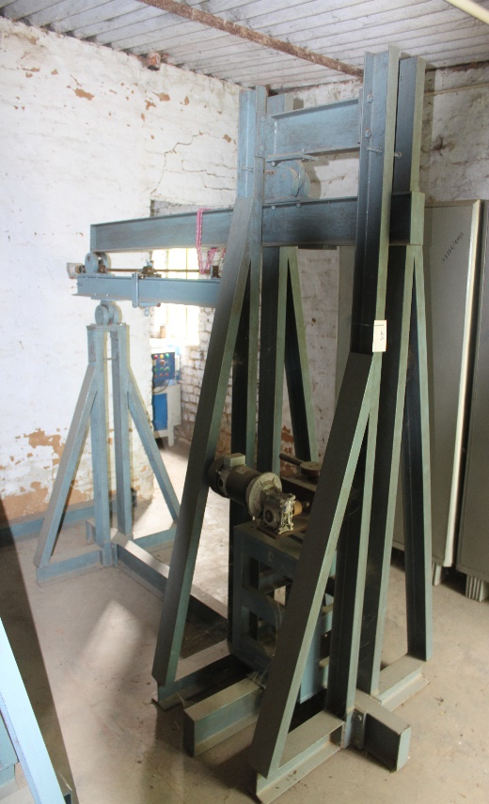
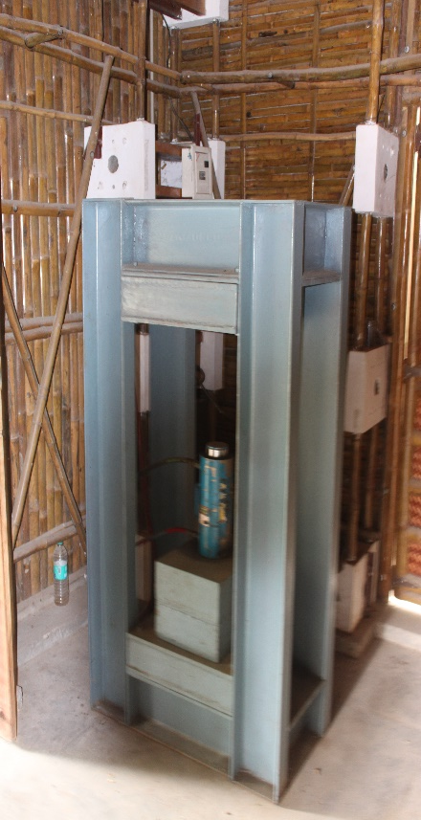
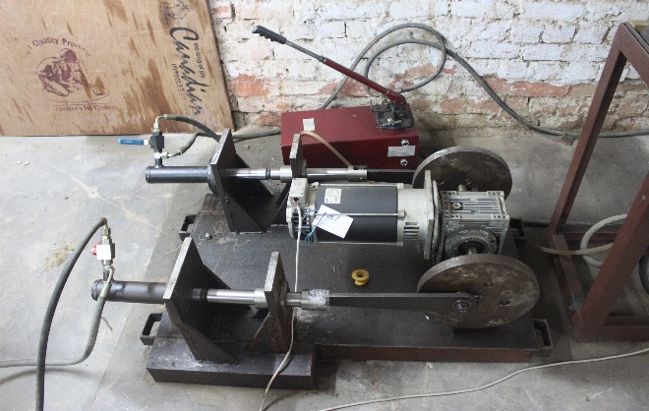
LOW COST EQUIPMENT DEVELOPED IN HOUSE
ARCH TEST
COMP. TEST
FATIGUE TEST
FATIGUE TEST
BENDING TEST
REACTION FRAME
COLUMN TEST
TENSION TEST
CREEP TEST
CYCLIC TEST

Slide 18
MULTI-LEVEL BAMBOO STRUCTURE

Slide 19
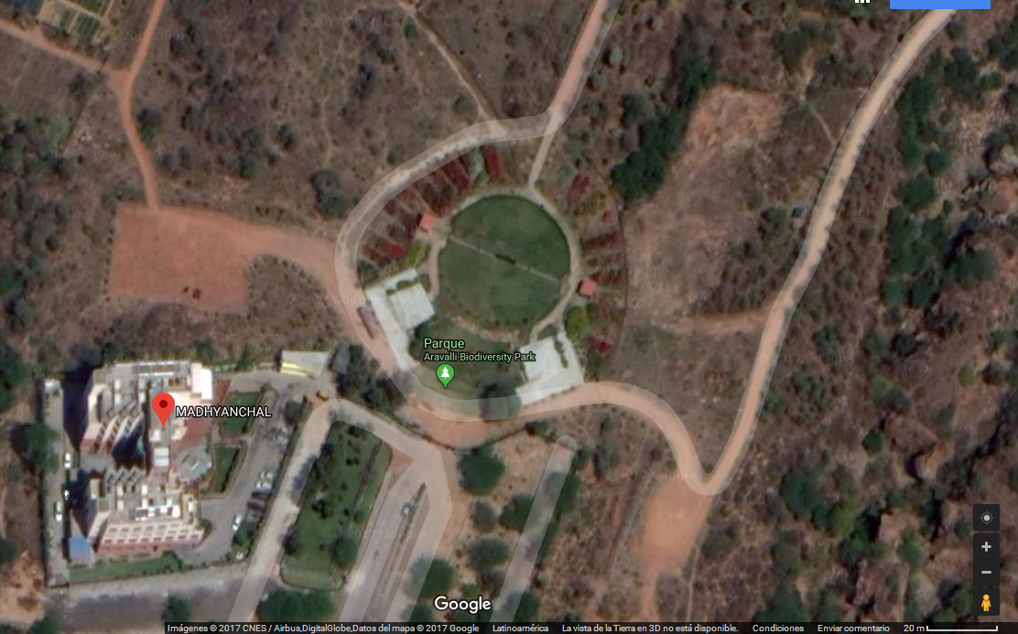
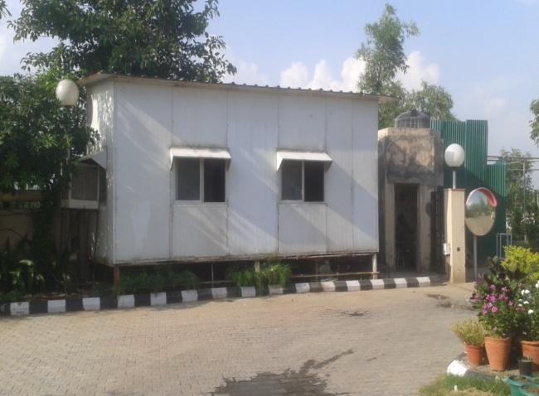
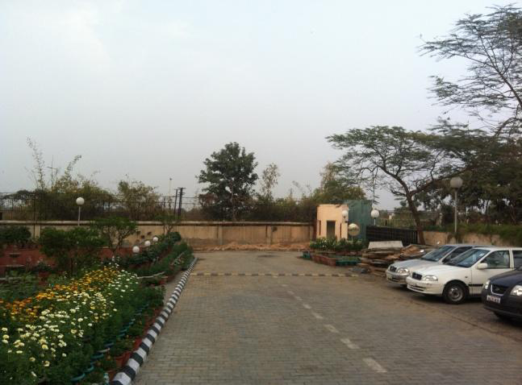
MULTI-LEVEL BAMBOO STRUCTURE
OPEN TERRAIN ON 3 SIDES
WIND SPEEDS 150 TO 170 KM/HR
NARROW SPACE & 12 PERSONS TO ACCOMMODATE

Slide 20
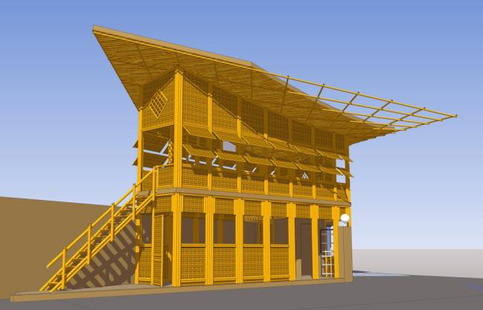
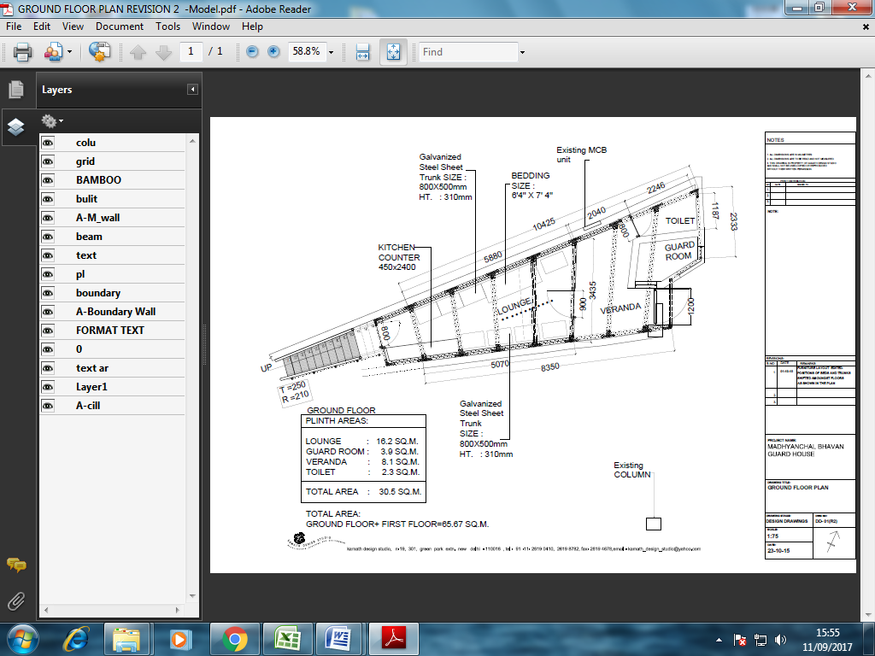
ARCHITECTURAL & STRUCTURAL MODELS

Slide 21
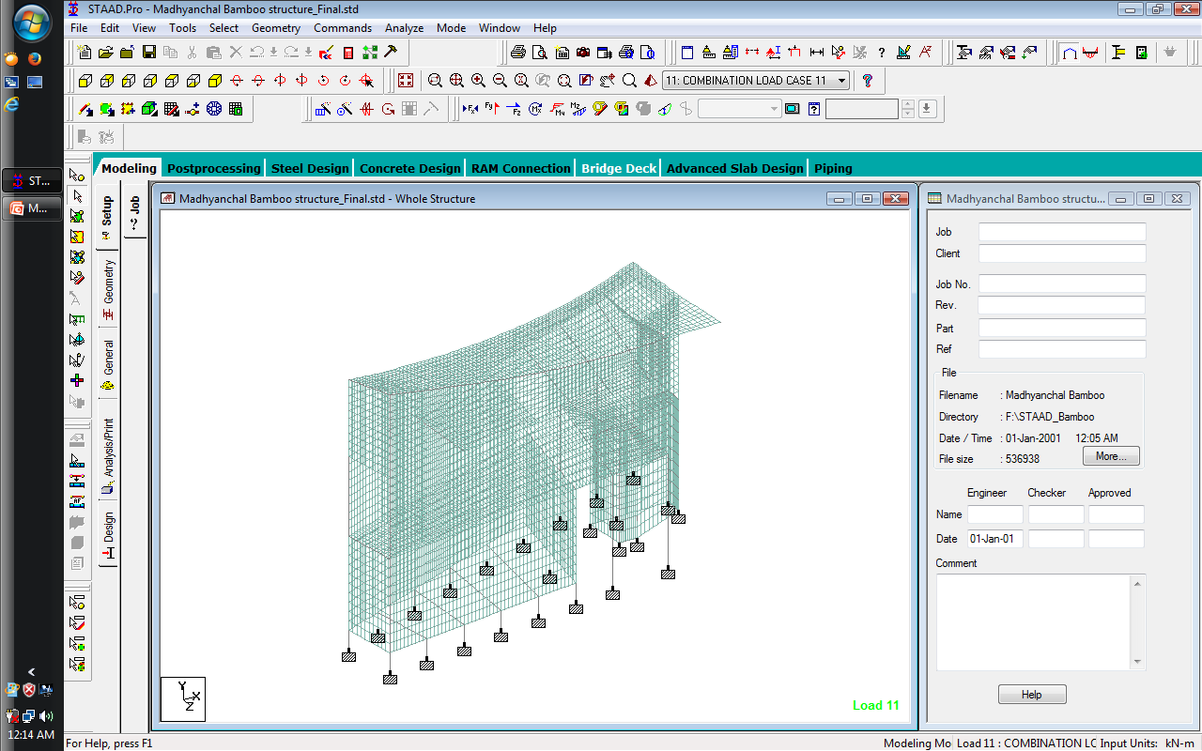
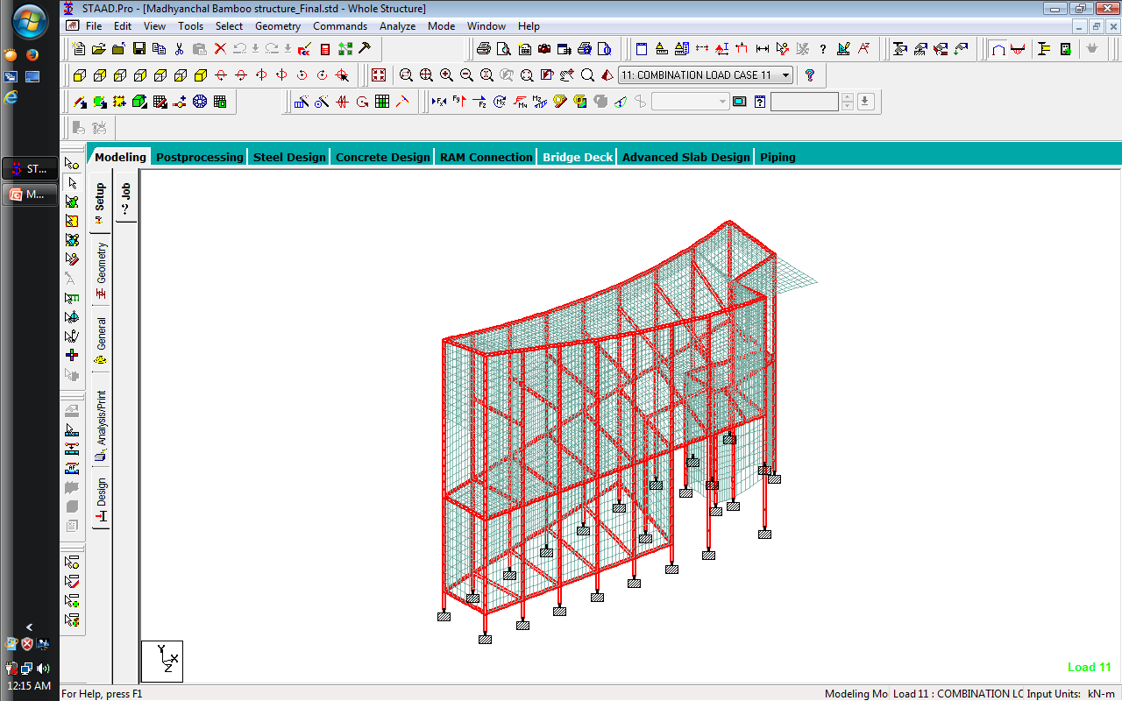
FEM MODELING

Slide 22
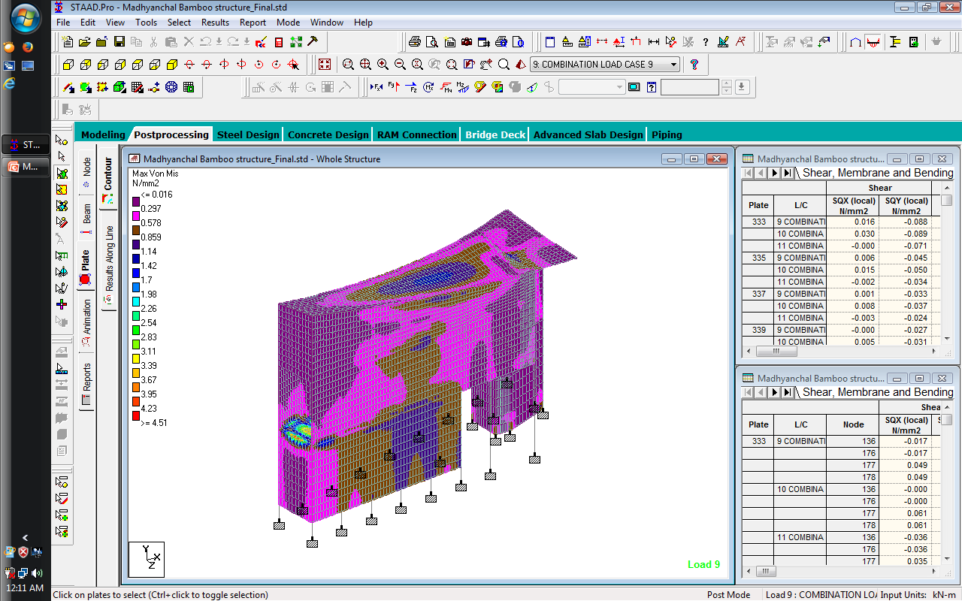
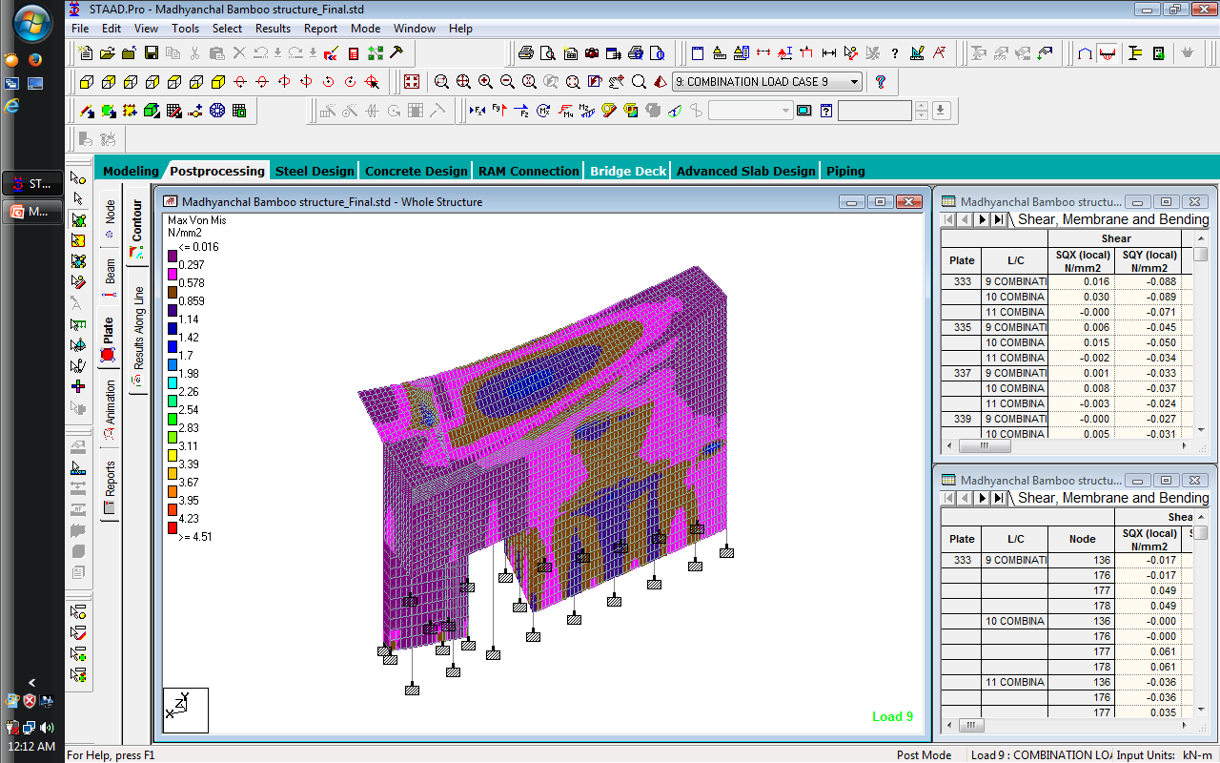
STRUCTURAL ANALYSIS: 1.5 (D.L + L.L)
Max Deflection = 2.4 mm

Slide 23
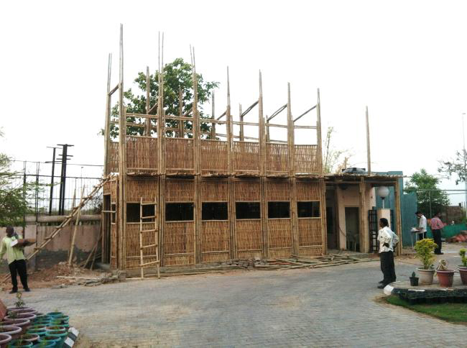
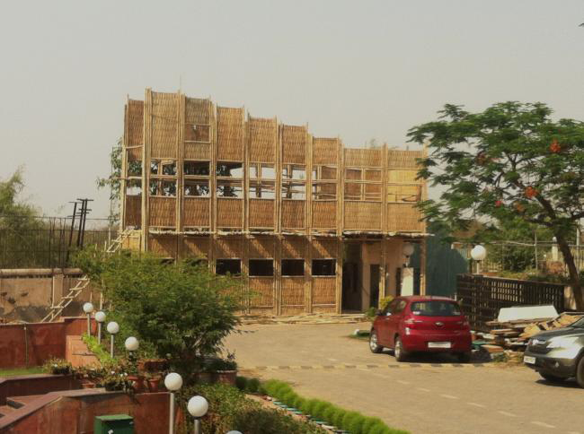
MULTI-LEVEL BAMBOO STRUCTURE

Slide 24
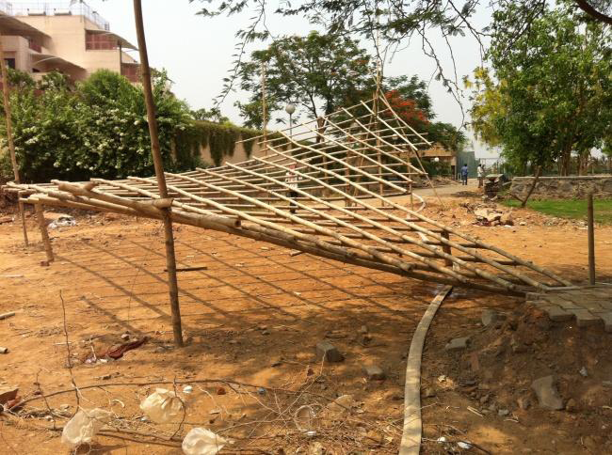
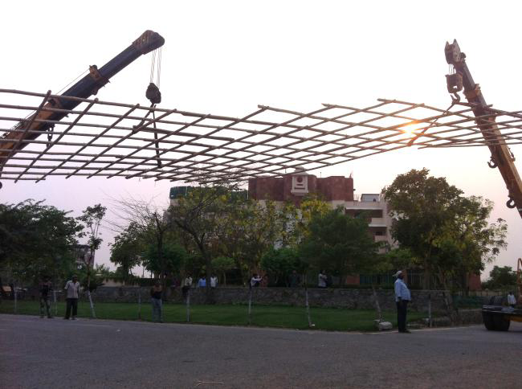
MULTI-LEVEL BAMBOO STRUCTURE

Slide 25
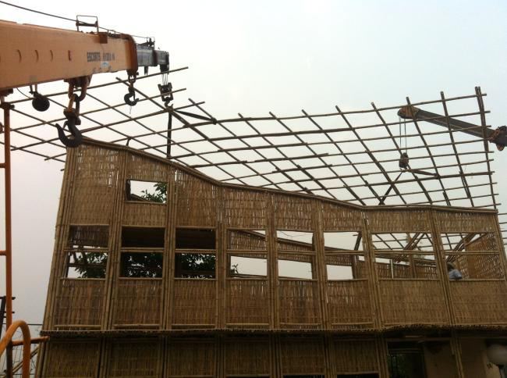
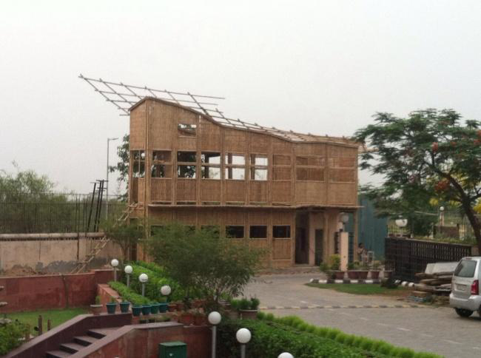
MULTI-LEVEL BAMBOO STRUCTURE

Slide 26
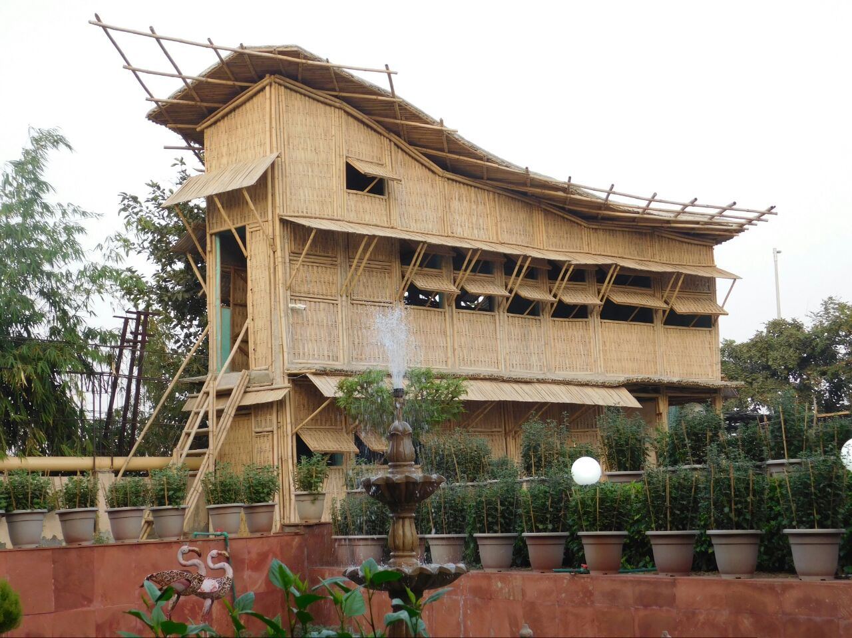
MULTI-LEVEL BAMBOO STRUCTURE

Slide 27

MULTI-LEVEL BAMBOO STRUCTURE, INDIA

Slide 28

MULTI-LEVEL BAMBOO STRUCTURE

Slide 29


MULTI-LEVEL BAMBOO STRUCTURE

Slide 30


MULTI-LEVEL BAMBOO STRUCTURE

Slide 31


Multi-level Bamboo Police Barrack
(Madhyanchal Bhawan, New Delhi)
ACKNOWLEDGEMENTS:
Funding agency: M.P. State Bamboo Mission, Gov. of Madhya Pradesh (Dr. Ajoy Bhattacharya & Shri B.B. Singh)
Designed & Built by: Green Bam Infra Tech Pvt Ltd., New Delhi, www.greenbam.in (Start-Up under Start-up India Program)

Slide 32


Bamboo Senior Citizen Shelter
(Madhyanchal Bhawan, New Delhi)
ACKNOWLEDGEMENTS:
Funding agency: Delhi Development Authority, New Delhi
Designed & Built by: Green Bam Infra Tech Pvt Ltd., New Delhi, www.greenbam.in (Start-Up under Start-up India Program)

Slide 33

Bamboo Gaushala (Cow Shed)
(at Karma Lakelands, Gurgaon, Haryana)
ACKNOWLEDGEMENTS:
Funding agency: Karma Lakelands, Gurgaon, Haryana
Designed & Built by: Green Bam Infra Tech Pvt Ltd., New Delhi, www.greenbam.in (Start-Up under Start-up India Program)

Slide 34

Bamboo Yoga Hall
(Delhi Development Authority, New Delhi)
ACKNOWLEDGEMENTS:
Funding agency: Delhi Development Authority, New Delhi
Designed & Built by: Green Bam Infra Tech Pvt Ltd., New Delhi, www.greenbam.in (Start-Up under Start-up India Program)

Slide 35


Golf Cart Parking Shed
(at Karma Lakelands, Gurgaon, Haryana)
ACKNOWLEDGEMENTS:
Funding agency: Karma Lakelands, Gurgaon, Haryana
Designed & Built by: Green Bam Infra Tech Pvt Ltd., New Delhi, www.greenbam.in (Start-Up under Start-up India Program)

Slide 36


Slide 37


Slide 38


Slide 39


Slide 40


Slide 41


Slide 42


Slide 43


CHOICE IS OURS
Artisan Training at IIT Delhi, 2007
Sustainable Technology
2 Bamboo Arch with 3 Nos. of 2 inch diameter Bamboo each, supporting 19 people
Technology to Just sustain
JAI HIND

